Slide 1
CALCULATOR APP
MOBILE APPLICATION DEVELOPMENT
Vedant Vispute (TYETC213)
Animesh Wankhede (TYETC214)
Pooja Kharde (TYETC217)
GUIDED BY:
Sphurti Deshmukh Mam

Slide 2
"String s11=e1.getText().toString();"
Implementation of Calculator App
1.Creating a new project and working with the activity_main.xml file. Navigate to the app > res > layout > activity_main.xml and add the below code to that file. Below is the code for the activity_main.xml file.
2.Working with the MainActivity.java file . In this method, first of all, we have to link two EditText with variables so that we can use them for our input. So link those edit box with variables we have written.
3. To input numbers in form of string using the getText() function .Use format
“String s11=e1.getText().toString();”.
S11 stores number of textbox1.
4. Same goes for textbox 2. To display the sum use setText() as follows:
Result.setText(final_sum.toString()).

Slide 3
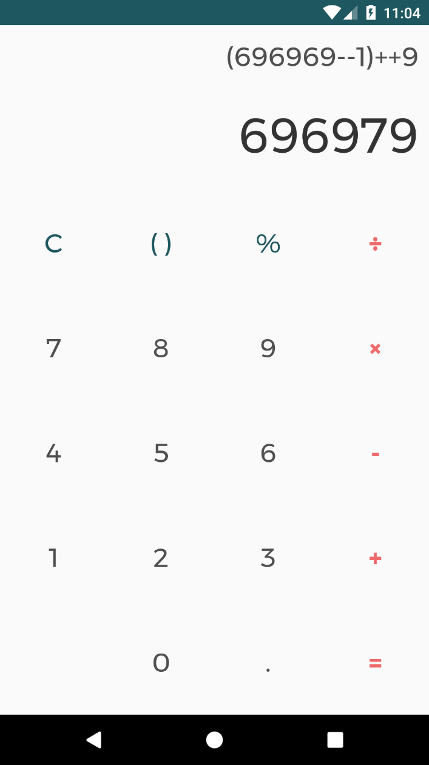
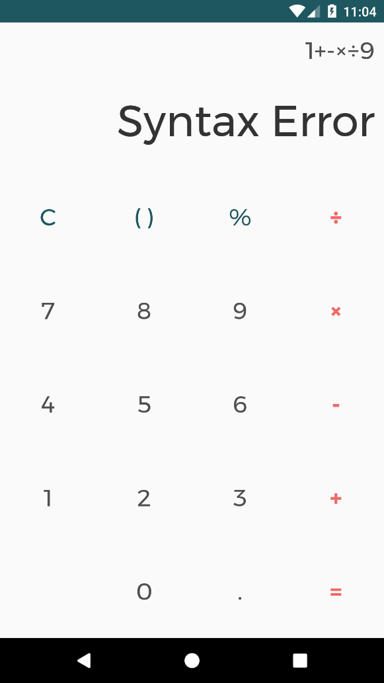
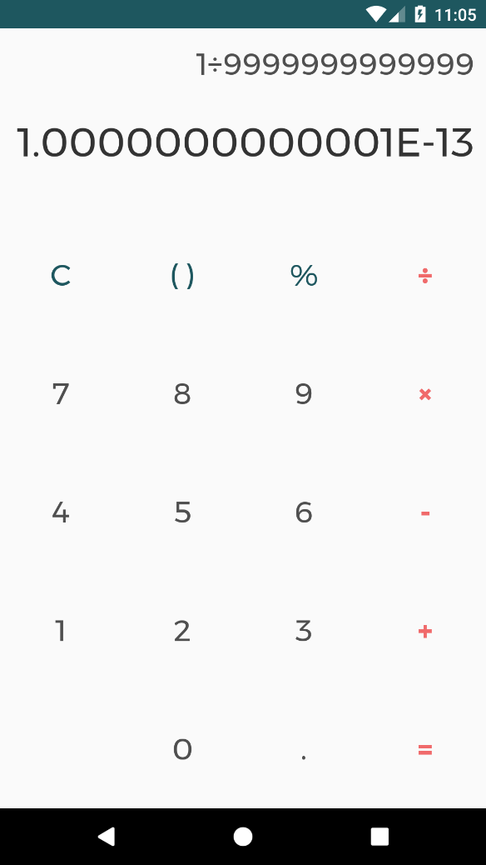
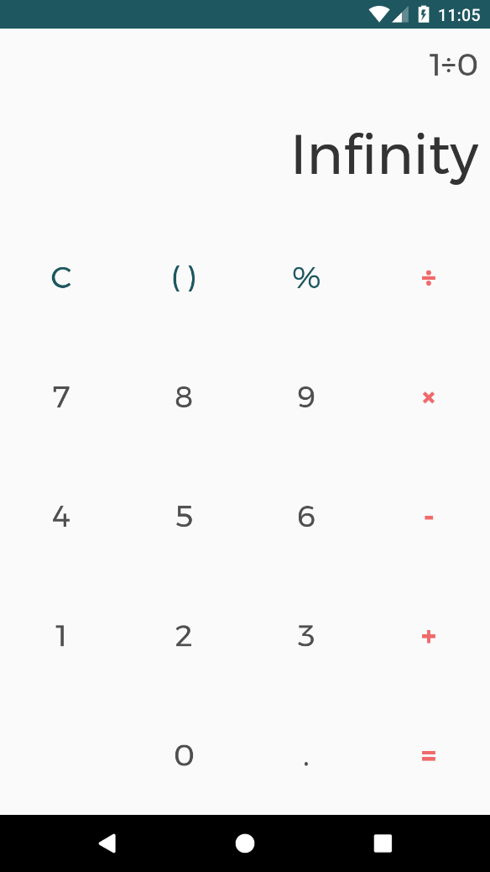
OUTPUT SCREENSHOTS:

Slide 4
THANK YOU…..!!!!!!

